Slide 1

ECEN 3593-001 Computer Organization
Lecture #14
19 February 2021

Slide 2


Agenda
Class Announcements
Phase 4
Chapter 4

Slide 3
Class Announcements
Phase 3 grades are posted (if you have completed it)
Scoring details in #phase3
Send a DM of “Phase3?” if you want your specific details
Starting tonight at 10:00 PM, Phase 3 deduction (which is now 10%) will increase to 5%/day

Slide 4
Class Announcements
Homework #2 is graded and reviewed
Answers will be enabled over the weekend when everyone has submitted

Slide 5
Class Announcements
Phase 5 of the project is posted
Target date is Sunday, February 28 at 10:00 PM
Bonus before the Target Date – 1%/day (Maximum 7%)
Deduction after the Target Date – 4%/day
A fresh starting project (including the IA Model) is included
Phase 5 is the CA implementation of ADD/ADDI/HALT
Project must be completed completely to receive any score
Next week several class sessions will include topics related to the Cycle Accurate (CA) model in Codasip

Slide 6
Why Create Schematics/Block Diagrams?
This is the real world process
Block diagrams are much easier to understand
What great idea of Computer Architecture is at work here? (Poll)
ABSTRACTION
A known correct schematic makes the Codasip Codal implementation much easier

Slide 7
Phase 4
Questions?

Slide 8
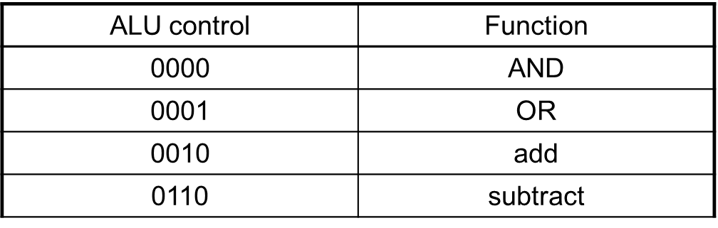
ALU Control
ALU used for:
Load/Store: F = add
Branch: F = subtract, xor, slt
R-type: F depends on opcode / funct3, funct7

Slide 9
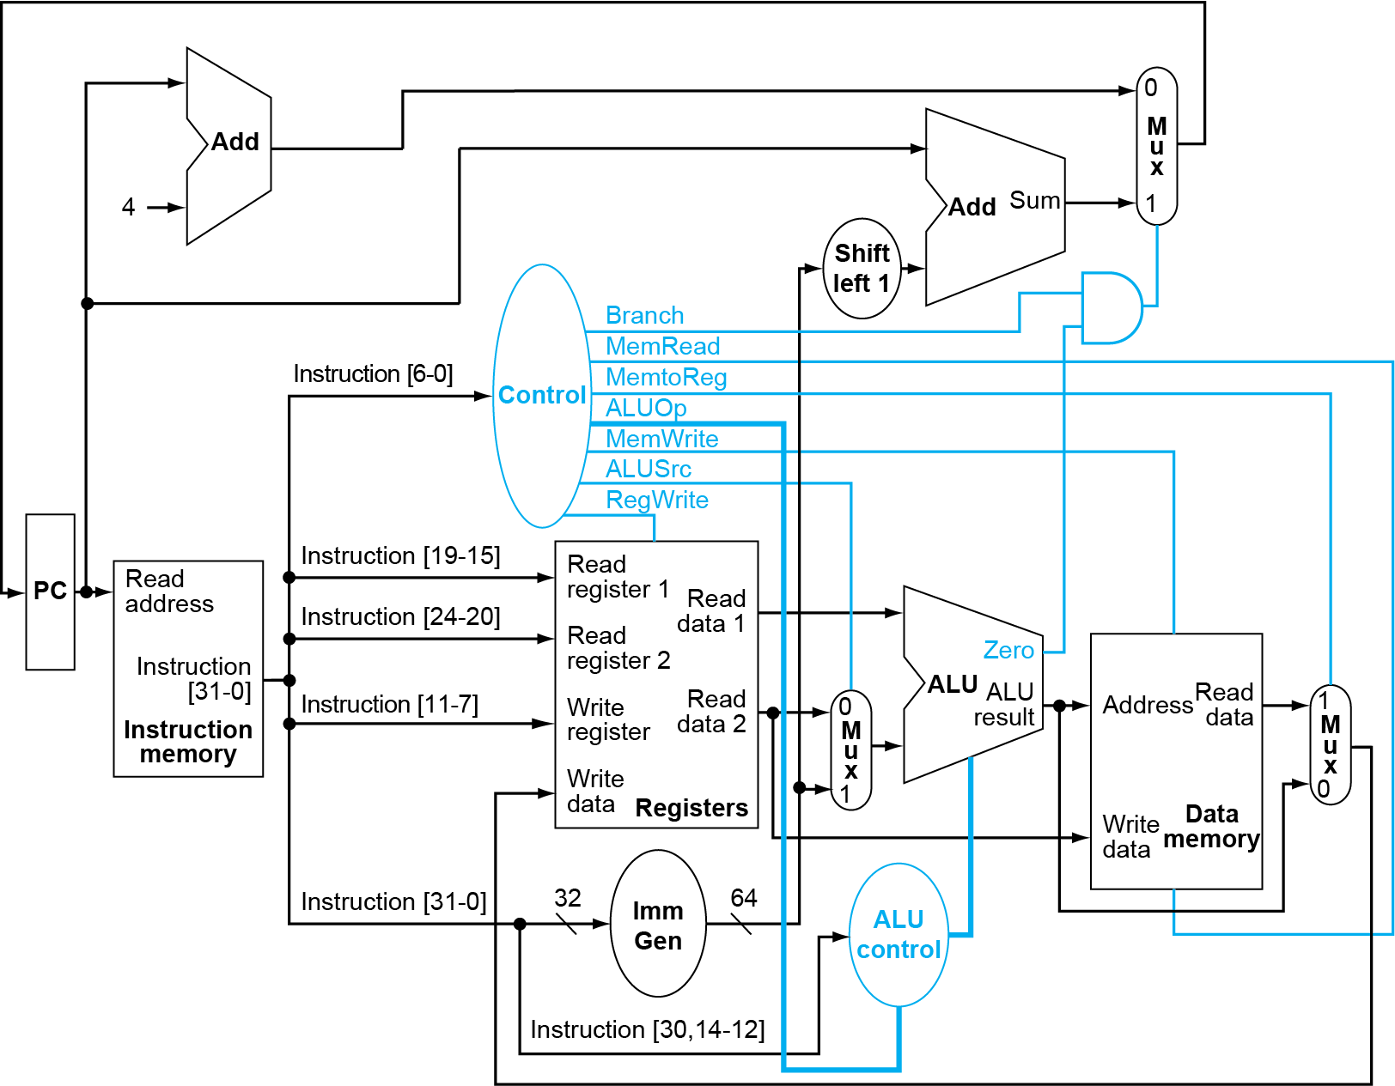
Full Data path with Control
This is a model of a single cycle CPU.
All instructions are completed in one clock cycle
You can view the ISA or Instruction Accurate model simulator as a single cycle CPU implementation
We will merge the ALU control decoding into the main Control DECODER
The DECODER will get bits [31:25], [14:12] and [6:0].
What instructions fields are these? (Poll)

Slide 10
Reviewing Single Cycle CPU model
Single-Cycle implementation refers to a CPU where one instruction is execute in once clock cycle
Clock period is determined by the longest instruction
Instruction memory → register file → ALU → register file
Instruction memory → register file → ALU → data memory → register file
Load/Stores require an extra step, access to data memory
Not feasible to vary period for different instructions
Thus, the load/store instruction defines the clock period / frequency in a single cycle machine
Violates design principle
Making the common case fast
Common case equals the slowest instruction in this design
Performance via pipelining can improve this performance bottleneck

Slide 11
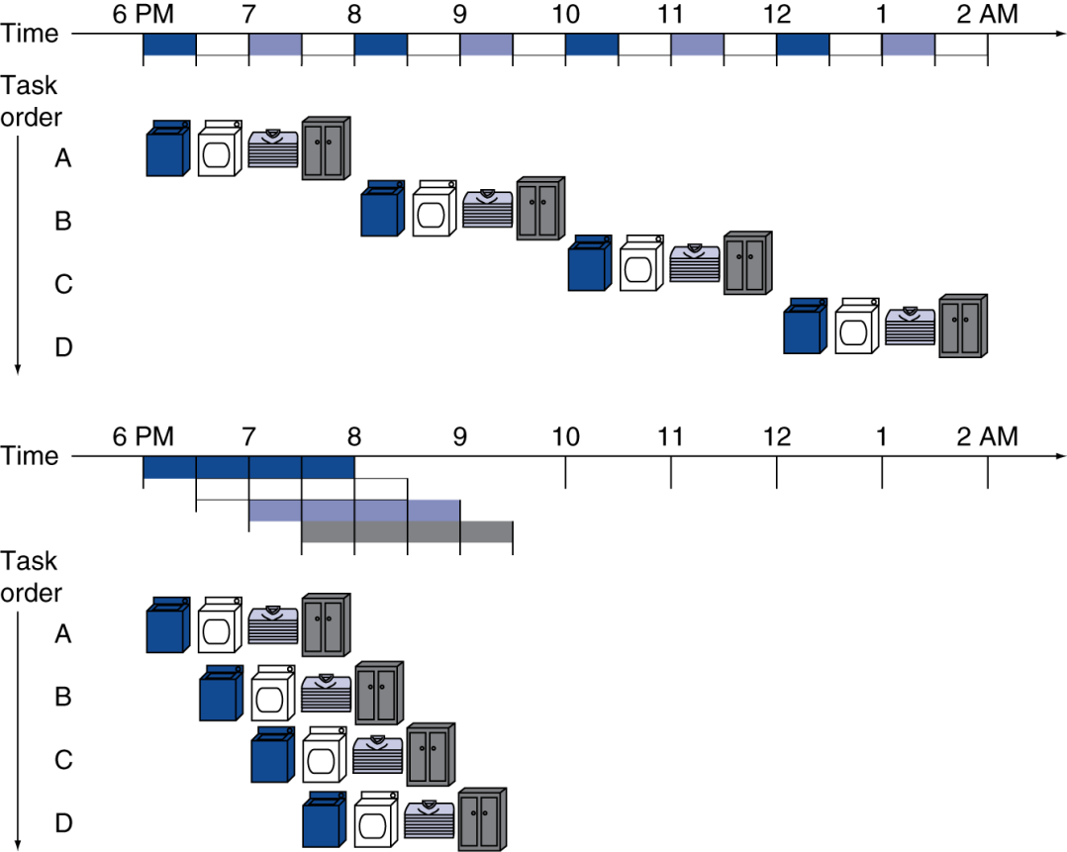
Performance Improvement via Pipelining
Pipelining is an implementation technique in which multiple instructions overlap in execution
Four loads:
Speedup = 16/7 ~ 2.3x
Non-stop:
Speedup = approaches the number of stages

Slide 12
RISC-V Pipeline
Stages are the steps in a pipeline that when an instruction goes through all the stages, the instruction is completed
Five stages, one step per stage
IF: Instruction fetch from memory
ID: Instruction decode & register read
EX: Execute operation or calculate address
MEM(ME): Access memory operand
WB: Write result back to register

Slide 13
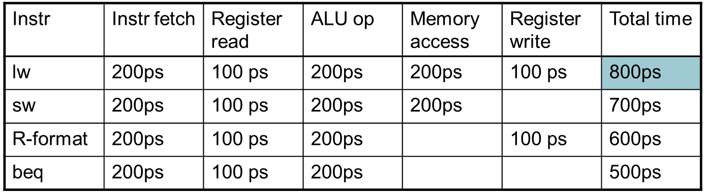
Pipeline Performance
Assume time for stages is
100ps for register read or write
200ps for other stages
Compare pipelined data path with single-cycle data path

Slide 14
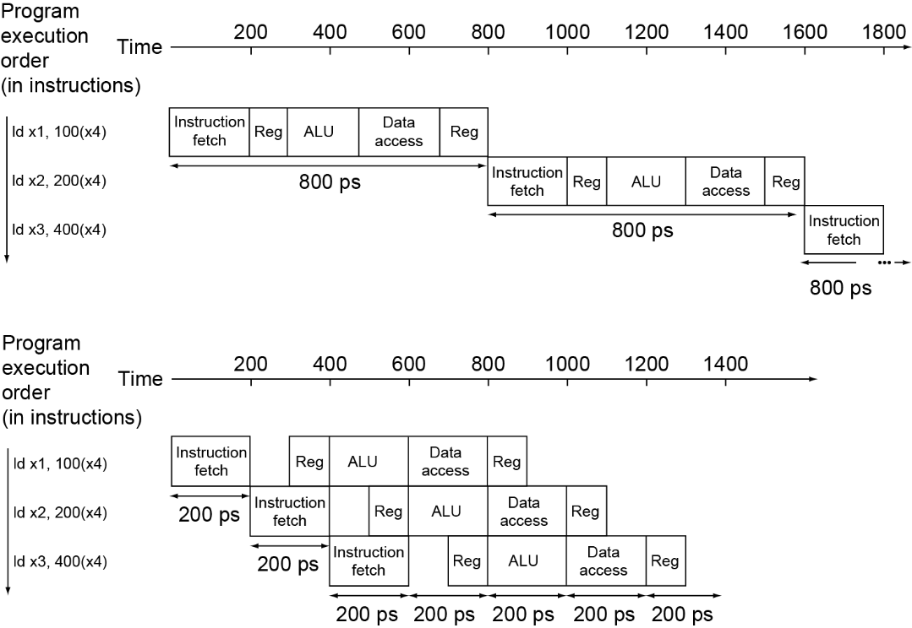
Pipeline Performance
Single-cycle (T_{c}= 800ps)
Pipelined (T_{c}= 200ps)

Slide 15
Pipeline Speedup
If all stages are balanced
i.e., all take the same time
Time between instructions_{pipelined} = Time between instructions_{nonpipelined} Number of stages
If not balanced, speedup is less
Speedup due to increased throughput
Latency (time for each instruction) does not decrease
Latency will actually increase for non-balanced stage design
But Throughput is increased!

Slide 16
Pipelining and ISA Design
RISC-V ISA designed for pipelining
All instructions are 32-bits
Easier to fetch and decode in one cycle
c.f. x86: 1- to 15-byte instructions
Few and regular instruction formats
Can decode and read registers in one step
Load/store addressing
Can calculate address in 3rd stage, access memory in 4th stage

Slide 17
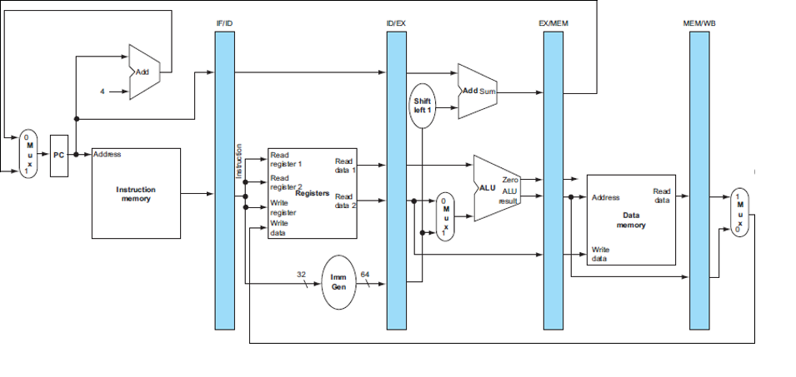
Pipelined Data Path
Book IF/ID -> our ID
Book ID/EX -> our EX
Book EX/MEM -> our ME
Book MEM/WB -> our WB

Slide 18
Pipelining Hazards
In a pipeline, there are situations that prevent starting the next instruction in the next cycle
Structural hazards
A required resource is busy
Data hazards
Need to wait for previous instruction to complete its data read/write
Control hazards
Deciding on control action depends on previous instruction

Slide 19
Structural Hazards
Structural hazards occur when a conflict of a resource prevent one of the instructions from proceeding down the pipe
In the RISC-V pipeline with a single memory
Load/store requires data access
Instruction fetch would have to stall for that cycle
Would cause a pipeline “bubble”
Hence, pipelined data paths require separate instruction/data memories
Or separate instruction/data caches

Slide 20
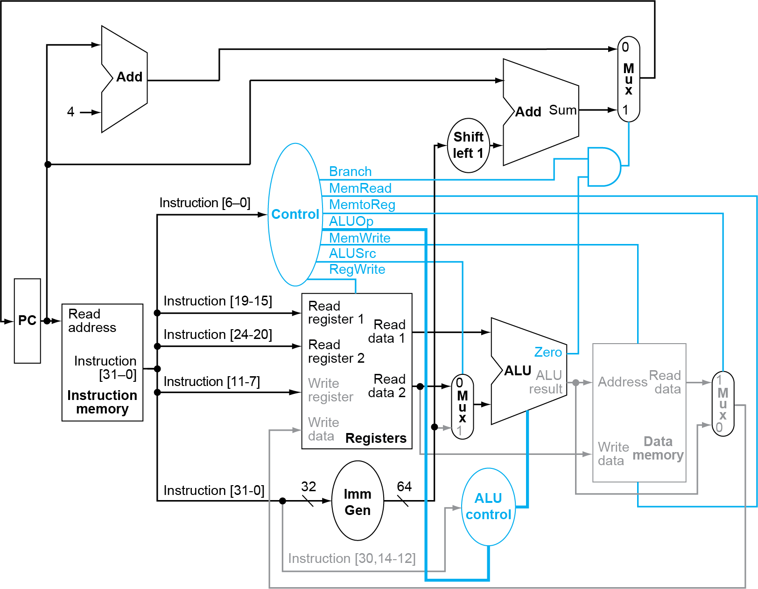
Structural Hazard
Adder and ALU
Could share them, but that would be a structural hazard

Slide 21
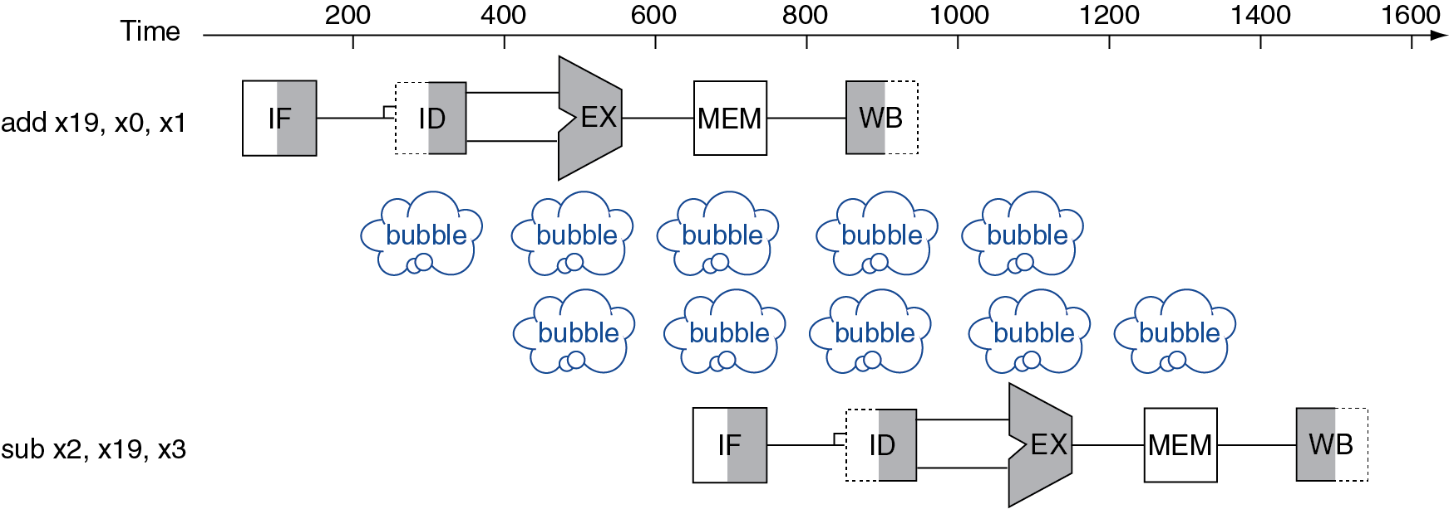
Data Hazards
Data hazards occur when the pipeline must be stalled because one stage must wait for another stage to complete
add x19, x0, x1 sub x2, x19, x3
Results from the dependency of one instruction on an earlier instruction that is still in the pipeline
Cannot start the sub instruction here

Slide 22
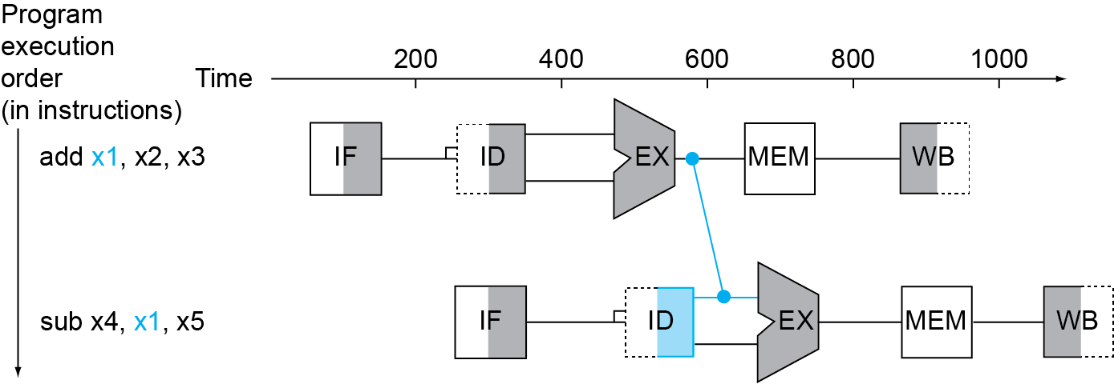
Forwarding (aka Bypassing)
Observe that the data is available before the instruction is completed
Use result when it is computed, not waiting for the instruction to complete
Don’t wait for it to be stored in a register
Requires extra connections in the data path
Forwarding paths are only valid if the destination stage is later in time than the source stage
Forwarding/Bypassing

Slide 23
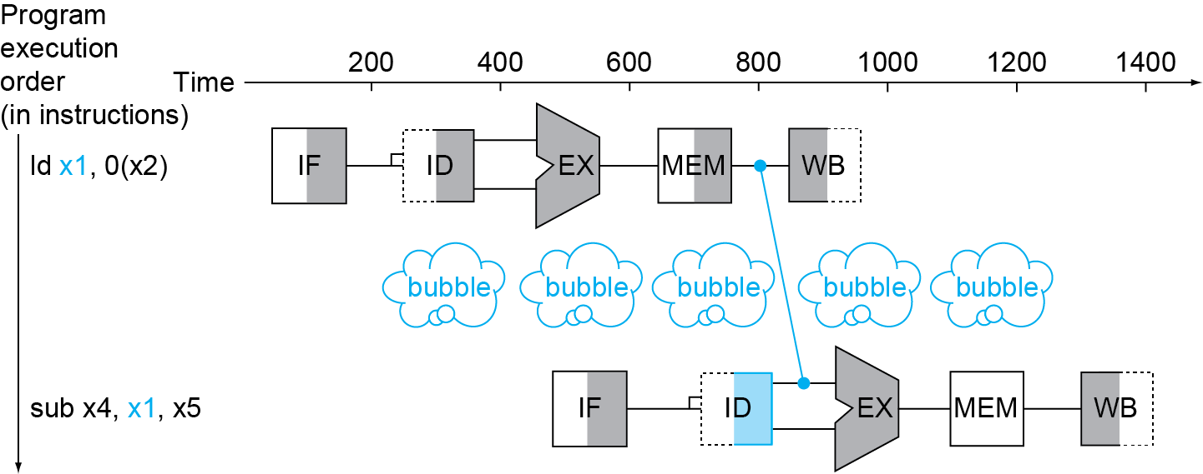
Load Use Data Hazard
Can’t always avoid stalls by forwarding
If value not computed when needed
Can’t forward backward in time!
The pipeline must stall for 1 cycle
If no forwarding, how many clock cycles would the CPU need to stall due to a Load Hazard? (Poll)

Slide 24
FBQ
First three correct answers submitted to #phase5 (NOT #phase2)
10 bonus points in Phase 5
Each person can only win the bonus points once

